Slide 1
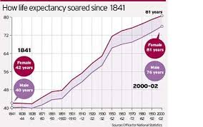
Life and death
Quantitative assessment
Life expectancy

Slide 2
Life and death
Quantitative assessment
Life expectancy
“Listen, my son, accept what I say, and the years of your life will be many.”
Prov 4v10

Slide 3
Life and death
Qualitative assessments
Health and life expectancy
Children’s children are a crown to the aged Prov 17v6a

Slide 4
Life and death
Qualitative assessments
Health and life expectancy
Experiences

Slide 5
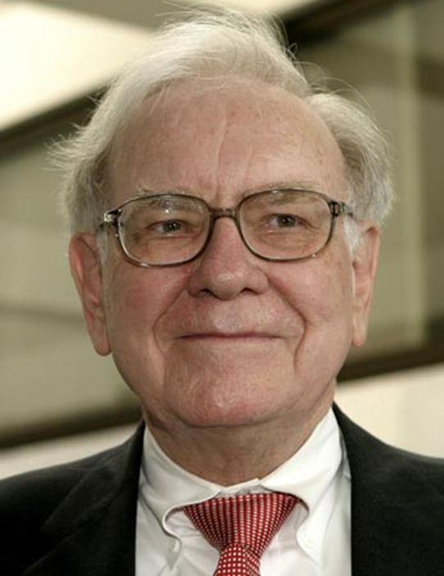
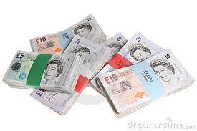
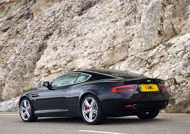
Life and death
Qualitative assessments
Health, life expectancy & experiences
Standard of living - wealth

Slide 6
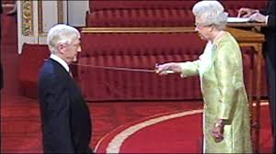
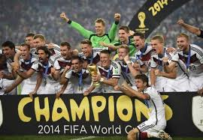
Life and death
Qualitative assessments
Health, life expectancy & experiences
Standard of living – wealth
Honour/prestige

Slide 7
Proverbs quality of life
Bible uses words “Life and Death” differently
“The soul is alienated from the life of God, is in a state of death until the entrance of God’s Word gives light and understanding”
Charles Bridges xf John 8v12
“Death reigned from the time of Adam”
Rom 5v14

Slide 8
Proverbs quality of life
“Death reigned from the time of Adam” Rom 5v14
What is the answer?
What wisdom is there?
“to those whom God has called, both Jews and Greeks, Christ the power of God and the wisdom of God.” 1 Cor 1v24
Jesus said ”I am the door. If anyone enters by me, he will be saved and will go in and out and find pasture. The thief comes only to steal and kill and destroy. I came that they may have life and have it abundantly.” John 10v9-10
Life is only known to those who are saved
Eternal and temporal

Slide 9
Proverbs quality of life
“Jesus said ”I am the door. If anyone enters by me, he will be saved and will go in and out and find pasture. The thief comes only to steal and kill and destroy. I came that they may have life and have it abundantly.” John 10v9-10
Life is only known to those who are saved
Eternal and temporal
How do we come into this life?
“For the wages of sin is death, but the gift of God is eternal life in Christ Jesus our Lord.” Rom 6v23
Xf Acts 16 Philippian jailer

Slide 10
Proverbs on Quality of Life
Christian, how do we live this abundant life before death?
“Whoever pursues righteousness and love finds life, prosperity and honour.”
Prov 21v21
“But seek first his kingdom and his righteousness, and all these things will be given to you as well.” Matt 6v33

Slide 11
Proverbs on Quality of Life
Abundant Life – Live it
Trust the promise :
“Whoever pursues righteousness and love finds life, prosperity and honour.” 21v21
Live the relationship
“for the Lord….takes the upright into His inner circle” 3v32b (Kidner)
Cultivate/enjoy the inner peace
“A heart at peace gives life to the body, but envy rots the bones” Prov 14v30
“Keep your heart with all vigilance, for from it flow the springs of life.” 4v23 ESV

Slide 12
Proverbs on Quality of Life
Live it – the outcome of inner peace
Trusting God and doing right
“My son, do not let wisdom and understanding out of your sight, preserve sound judgment and discretion; ²² they will be life for you, an ornament to grace your neck. ²³ Then you will go on your way in safety, and your foot will not stumble. ²⁴ When you lie down, you will not be afraid; when you lie down, your sleep will be sweet. ²⁵ Have no fear of sudden disaster or of the ruin that overtakes the wicked, ²⁶ for the Lord will be at your side and will keep your foot from being snared.” 3v21-26

Slide 13
Proverbs on Quality of Life
Live it – the outcome of inner peace
By trusting God and doing right
“²⁷ Do not withhold good from those to whom it is due, when it is in your power to act. ²⁸ Do not say to your neighbour, ‘Come back tomorrow and I’ll give it to you’– when you already have it with you. ²⁹ Do not plot harm against your neighbour, who lives trustfully near you. ³⁰ Do not accuse anyone for no reason – when they have done you no harm. ³¹ Do not envy the violent or choose any of their ways. ³² For the Lord detests the perverse but takes the upright into his confidence.” 3v27-32
Contrast David and Saul
Also ref v29 David and Uriah

Slide 14
Proverbs on Quality of Life
Abundant Life – Live it
Abundant Life – Love it
How? By hearty rejoicing and worship
WSC Q1 What is the chief end of man?
To glorify God and to enjoy Him for ever
David dancing before the Lord!
Even when the victory wasn’t ours
Because the victory is never ours!

Slide 15
Proverbs on Quality of Life
Abundant Life – Live it
Abundant Life – Love it
Abundant Life – Share it
How? By how we speak
“The soothing tongue is a tree of life, but a deceitful tongue crushes the spirit.” 15v4
Warm witness
Building up our brothers
Barriers to building others up?
Envy/insecurity

Slide 16
Proverbs on Quality of Life
Abundant Life – Live it
Abundant Life – Love it
Abundant Life – Share it
Abundant Life – Use it
How? By taking William Carey’s example “Expect great things of God; attempt great things for God”
“Whoever pursues righteousness and love finds life, prosperity and honour. ²² One who is wise can go up against the city of the mighty and pull down the stronghold in which they trust.” 21v21-22

Slide 17
Proverbs on Quality of Life
Abundant Life – Use it
How? By prayer
“For though we live in the world, we do not wage war as the world does. ⁴ The weapons we fight with are not the weapons of the world. On the contrary, they have divine power to demolish strongholds. ⁵ We demolish arguments and every pretension that sets itself up against the knowledge of God, and we take captive every thought to make it obedient to Christ.” 2 Cor 10v3-5

Slide 18
Proverbs on Quality of Life
Abundant Life – Use it
How? By prayer
“On the contrary, they have divine power to demolish strongholds.” 2 Cor 10v4
“With your help I can run through a barricade; with my God I can scale a wall.” Psalm 18v29

